Slide 1
Module: 4:
Learning and Probabilistic reasoning in AI

Slide 2
LEARNING
We describe agents that can improve their behavior through diligent study of past experiences and predictions about the future.
An agent is learning if it improves its performance after making observations about the world.
When the agent is a computer, we call it machine learning:
A computer observes some data, builds a model based on the Machine learning data, and uses the model as both a hypothesis about the world and a piece of software that can solve problems.
The goals of learning are understanding and prediction.

Slide 3
MACHINE LEARNING
Machine learning is a subset of artificial intelligence (AI) that provides systems the ability to automatically learn and improve from experience without being explicitly programmed

Slide 4
Forms of Learning
Any component of an agent program can be improved by machine learning.
The improvements, and the techniques used to make them, depend on these factors:
Which component is to be improved.
What prior knowledge the agent has, which influences the model it builds.
What data and feedback on that data is available.

Slide 5
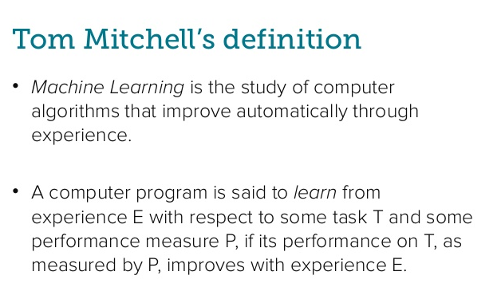

Slide 6


Slide 7
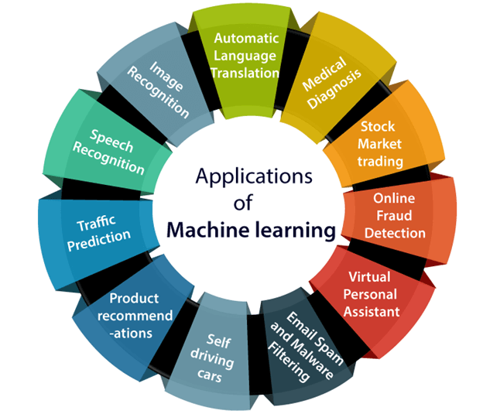

Slide 8
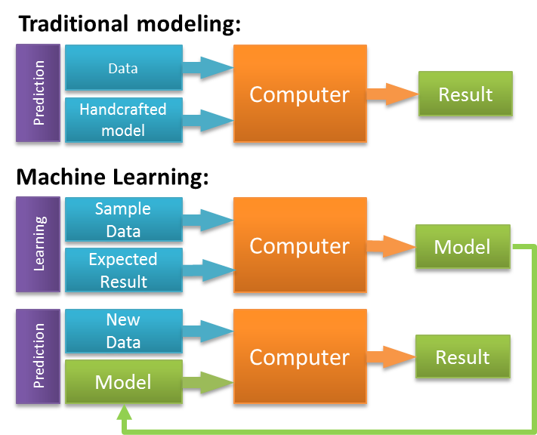

Slide 9
Step 1
Gathering data from various sources
Step 2
Cleaning data
Step 3
Model Building –Selecting the right ML algorithm
Step 4
Gaining insights from the model’s results
Step 5
Data Visualization –Transforming results into visual graphs
STEPS INVOLVED IN MACHINE LEARNING PROCESS

Slide 10
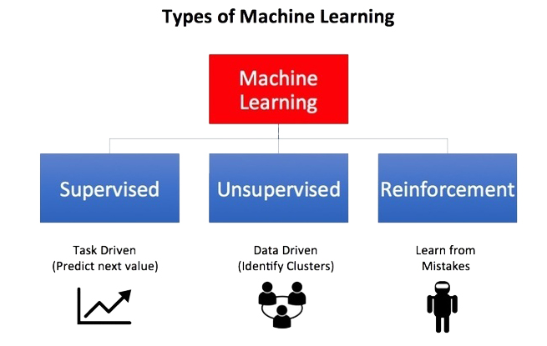

Slide 11
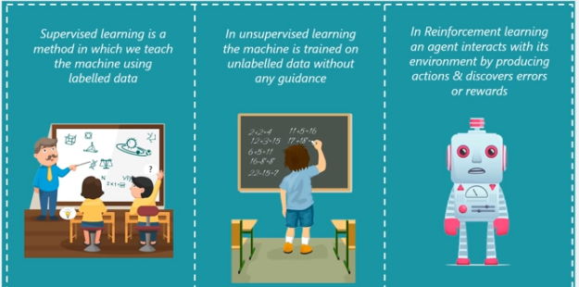
DEFINITION

Slide 12
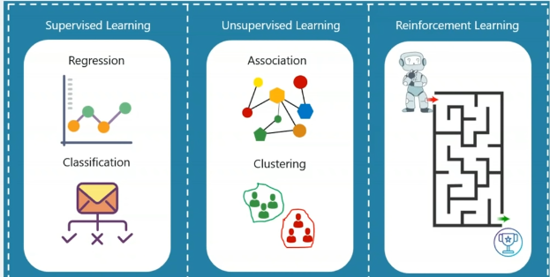
PROBLEM TYPE

Slide 13
Forms of Learning
Which component is to be improved
direct mapping from conditions on the current state to actions
infer relevant properties of the world
results of possible actions
Action-value information
Goals that describe classes of states

Slide 14
Forms of Learning
What prior knowledge the agent already has.
What representation is used for the data and the component.
representations: propositional and first-order logical sentences
Bayesian networks for the inferential components
factored representation—a vector of attribute values—and outputs that can be either a continuous numerical value or a discrete value

Slide 15
Forms of Learning
What feedback is available to learn from :
Types of feedback that determine the three main types of learning
supervised learning the agent observes some example input–output pairs and learns a function that maps from input to output
unsupervised learning the agent learns patterns in the input even though no explicit feedback is supplied
reinforcement learning the agent learns from a series of reinforcements—rewards or punishments. For example, at the end of a chess game the agent is told that it has won (a reward) or lost (a punishment).

Slide 16
Statistical learning
Statistical learning theory is a framework for machine learning drawing from the fields of statistics and functional analysis.
Statistical learning theory deals with the problem of finding a predictive function based on data.
Statistical learning theory has led to successful applications in fields such as computer vision, speech recognition, and bioinformatics.

Slide 17
Statistical learning
The goals of learning are understanding and prediction. Learning falls into many categories, including supervised learning, unsupervised learning, online learning, and reinforcement learning.
From the perspective of statistical learning theory, supervised learning is best understood.
Supervised learning involves learning from a training set of data.
Every point in the training is an input-output pair, where the input maps to an output.
The learning problem consists of inferring the function that map between the input and the output, such that the learned function can be used to predict the output from future input.

Slide 18
Supervised learning
Supervised learning, as the name indicates, has the presence of a supervisor as a teacher. supervised learning is based on training
Basically supervised learning is when we teach or train the machine using data that is well labeled.
Which means some data is already tagged with the correct answer.
After that, the machine is provided with a new set of examples(data) so that the supervised learning algorithm analyses the training data(set of training examples) and produces a correct outcome from labeled data.

Slide 19
Supervised learning
Supervised learning is classified into two categories of algorithms:
Classification: A classification problem is when the output variable is a category, such as “Red” or “blue” or “disease” and “no disease”.
Regression: A regression problem is when the output variable is a real value, such as “dollars” or “weight”.
Supervised learning deals with or learns with “labeled” data. This implies that some data is already tagged with the correct answer.
Types:- (Regression, Logistic Regression, Classification, Naive Bayes Classifiers, K-NN (k nearest neighbors), Decision Trees, Support Vector Machine)

Slide 20


Supervised learning
For instance, suppose you are given a basket filled with different kinds of fruits.
Now the first step is to train the machine with all different fruits one by one like this:
If the shape of the object is rounded and has a depression at the top, is red in color, then it will be labeled as –Apple.
If the shape of the object is a long curving cylinder having Green-Yellow color, then it will be labeled as –Banana.
Now suppose after training the data, you have given a new separate fruit, say Banana from the basket, and asked to identify it.

Slide 21
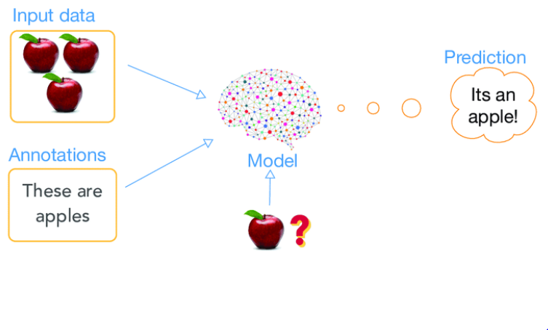
SUPERVISED LEARNING- CLASSIFICATION

Slide 22
Supervised learning
Advantages:-
Supervised learning allows collecting data and produces data output from previous experiences.
Helps to optimize performance criteria with the help of experience.
Supervised machine learning helps to solve various types of real-world computation problems.
Disadvantages:-
Classifying big data can be challenging.
Training for supervised learning needs a lot of computation time. So, it requires a lot of time.

Slide 23
Supervised learning
Regression models
Regression tasks are different, as they expect the model to produce a numerical relationship between the input and output data.
Examples of regression models include predicting real estate prices based on zip code, or predicting click rates in online ads in relation to time of day, or determining how much customers would be willing to pay for a certain product based on their age.

Slide 24
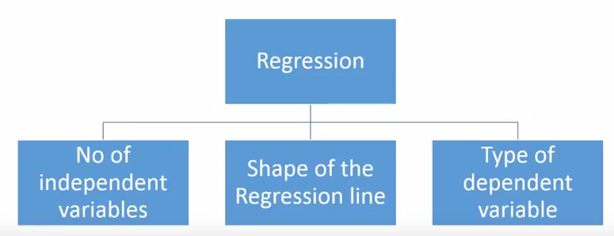
How many types of regression techniques do we have?
There are various kinds of regression techniques available to make predictions. These techniques are mostly driven by three metrics (number of independent variables, type of dependent variables and shape of regression line). We’ll discuss them in detail in the following sections.

Slide 25
Supervised Learning
Supervised learning is the machine learning task of learning a function that maps an input to an output based on example input-output pairs.
It infers a function from labeled training data consisting of a set of training examples.
In supervised learning, each example is a pair consisting of an input object and a desired output value.
A supervised learning algorithm analyzes the training data and produces an inferred function, which can be used for mapping new examples.
An optimal scenario will allow for the algorithm to correctly determine the class labels for unseen instances.
This requires the learning algorithm to generalize from the training data to unseen situations in a "reasonable" way

Slide 26
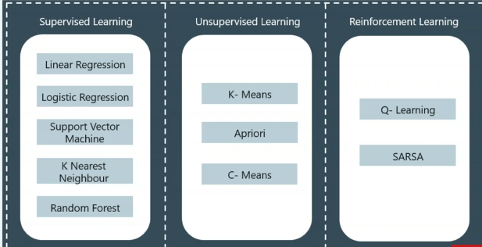
ALGORITHMS

Slide 27
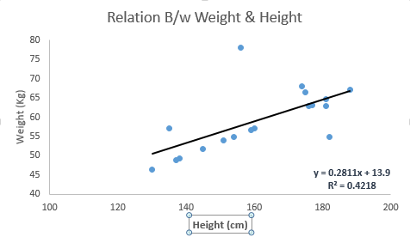
Linear Regression
It is one of the most widely known modeling technique. Linear regression is usually among the first few topics which people pick while learning predictive modeling. In this technique, the dependent variable is continuous, independent variable(s) can be continuous or discrete, and nature of regression line is linear.
Linear Regression establishes a relationship between dependent variable (Y) and one or more independent variables (X) using a best fit straight line (also known as regression line).
It is represented by an equation Y=a+b*X + e, where a is intercept, b is slope of the line and e is error term. This equation can be used to predict the value of target variable based on given predictor variable(s).
The difference between simple linear regression and multiple linear regression is that, multiple linear regression has (>1) independent variables, whereas simple linear regression has only 1 independent variable. Now, the question is “How do we obtain best fit line?”.

Slide 28
Supervised learning
Classification algorithms
An algorithm that maps the input data to a specific category.
A classification algorithm aims to sort inputs into a given number of categories or classes, based on the labeled data it was trained on.
Classification algorithms can be used for binary classifications such as filtering email into spam or non-spam and categorizing customer feedback as positive or negative.
Feature recognition, such as recognizing handwritten letters and numbers or classifying drugs into many different categories, is another classification problem solved by supervised learning.

Slide 29
Supervised learning
Types of Classifications
Binary Classification: Classification task with two possible outcomes.
Eg: Gender classification (Male / Female)
Multi-class classification: Classification with more than two classes. In multi class classification each sample is assigned to one and only one target label. Eg: An animal can be cat or dog but not both at the same time
Multi-label classification: Classification task where each sample is mapped to a set of target labels (more than one class). Eg: A news article can be about sports, a person, and location at the same time.

Slide 30
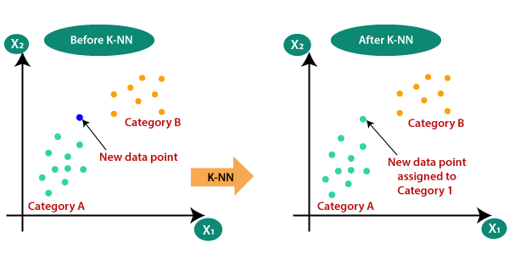
Supervised learning
K-Nearest Neighbor Algorithm
KNN works on the very same principle. It classifies the new data points depending upon the class of the majority of data points amongst the K neighbor, where K is the number of neighbors to be considered.
KNN captures the idea of similarity (sometimes called distance, proximity, or closeness) with some basic mathematical distance formulas like euclidean distance, Manhattan distance, etc.

Slide 31
Choosing the right value for K
To select the K that’s right for the data you want to train, run the KNN algorithm several times with different values of K and choose that value of K which reduces the number of errors on unseen data.
Pros:
KNN is simple and easiest to implement.
There’s no need to build a model, tuning several parameters, or make additional assumptions like some of the other classification algorithms.
It can be used for classification, regression, and search. So, it is flexible.
Cons:
The algorithm gets significantly slower as the number of examples and/or predictors/independent variables increase.

Slide 32
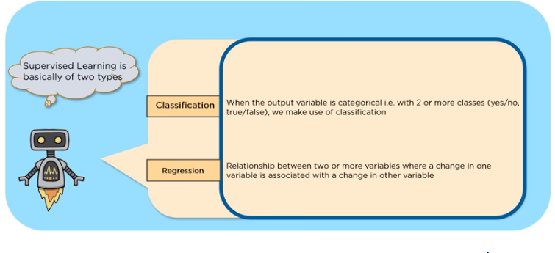
TYPES OF SUPERVISED LEARNING

Slide 33
POLL QUESTIONS
Identify whether the following data is categorical or continuous value
Temperature
Yes or No
True or False
Price
Fit or unfit
Apple or Orange
Humidity

Slide 34
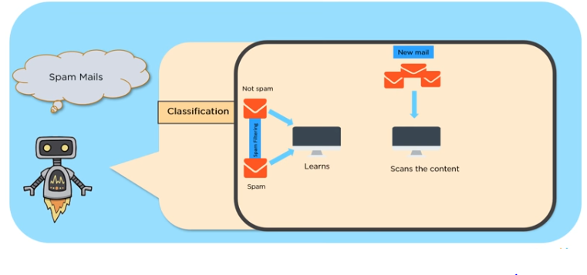
CLASSIFICATION EXAMPLE

Slide 35
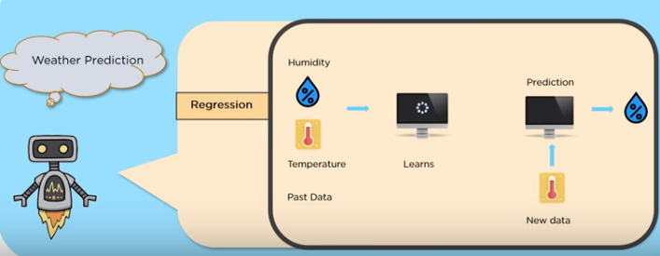
REGRESSION EXAMPLE

Slide 36
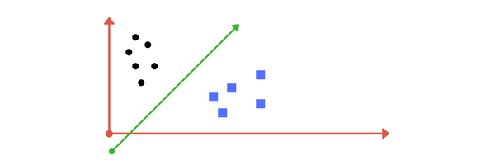
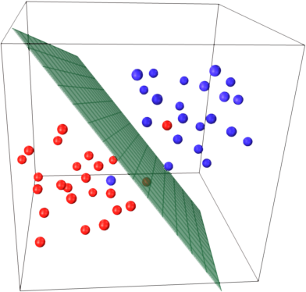
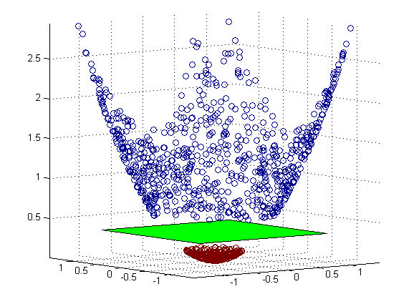
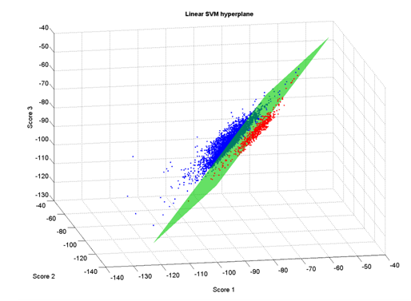
SVM
A Support Vector Machine (SVM) is a discriminative classifier formally defined by a separating hyperplane.
Given labeled training data (supervised learning), the algorithm outputs an optimal hyperplane which categorizes new examples.
In two dimentional space this hyperplane is a line dividing a plane in two parts where in each class lay in either side.

Slide 37
Decision Tree
A decision tree is a decision support tool that uses a tree-like graph
It is one way to display an algorithm that only contains conditional control statements.
A decision tree is a flowchart-like structure in which each internal node represents a “test” on an attribute (e.g. whether a coin flip comes up heads or tails), each branch represents the outcome of the test, and each leaf node represents a class label (decision taken after computing all attributes).
The paths from root to leaf represent classification rules.
Decision Tree algorithms are referred to as CART (Classification and Regression Trees), ID3,C4.5

Slide 38
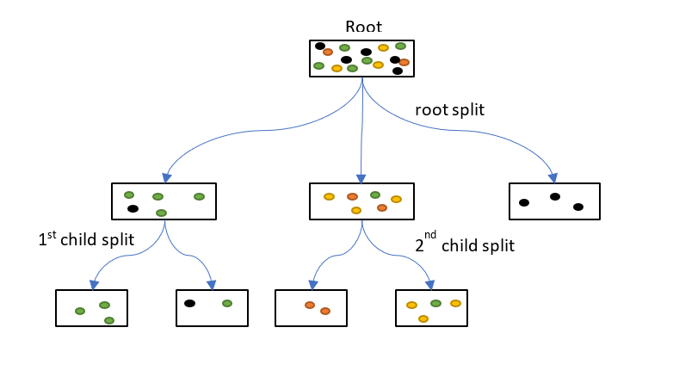
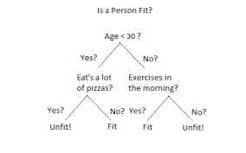
Decision Tree

Slide 39
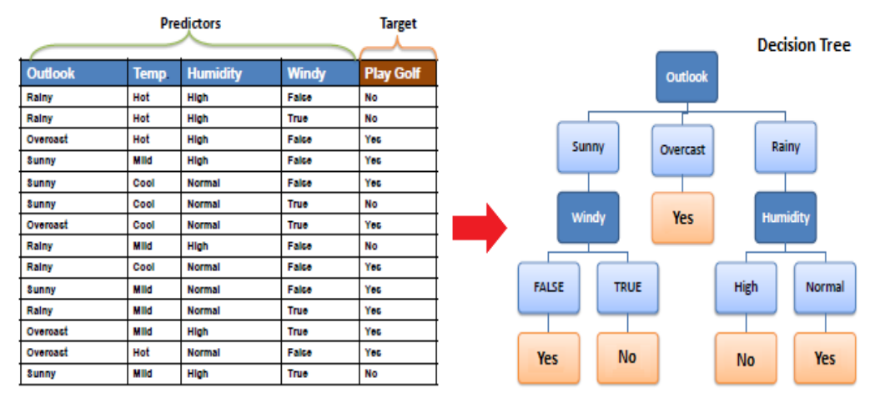

Slide 40
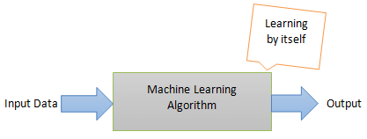
Unsupervised Learning
Unsupervised learning, on the other hand, is the method that trains machines to use data that is neither classified nor labeled. It means no training data can be provided and the machine is made to learn by itself. The machine must be able to classify the data without any prior information about the data.
The idea is to expose the machines to large volumes of varying data and allow it to learn from that data to provide insights that were previously unknown and to identify hidden patterns. As such, there aren’t necessarily defined outcomes from unsupervised learning algorithms. Rather, it determines what is different or interesting from the given dataset.
The machine needs to be programmed to learn by itself. The computer needs to understand and provide insights from both structured and unstructured data. Here’s an accurate illustration of unsupervised learning:

Slide 41

For instance, suppose it is given an image having both dogs and cats which it has never seen.
Thus the machine has no idea about the features of dogs and cats so we can’t categorize it as ‘dogs and cats ‘. But it can categorize them according to their similarities, patterns, and differences, i.e., we can easily categorize the above picture into two parts. The first may contain all pics having dogs in them and the second part may contain all pics having cats in them. Here you didn’t learn anything before, which means no training data or examples.
It allows the model to work on its own to discover patterns and information that was previously undetected. It mainly deals with unlabelled data.

Slide 42
Unsupervised Learning
Unsupervised Machine Learning Categorization
1) Clustering is one of the most common unsupervised learning methods. The method of clustering involves organizing unlabelled data into similar groups called clusters. Thus, a cluster is a collection of similar data items. The primary goal here is to find similarities in the data points and group similar data points into a cluster.
2) Association Association rules allow you to establish associations amongst data objects inside large databases. This unsupervised technique is about discovering interesting relationships between variables in large databases. For example, people that buy a new home most likely to buy new furniture.

Slide 43
Unsupervised Learning
Applications of Unsupervised Learning Algorithms
Some practical applications of unsupervised learning algorithms include:
Fraud detection
Malware detection
Identification of human errors during data entry
Conducting accurate basket analysis, etc.

Slide 44
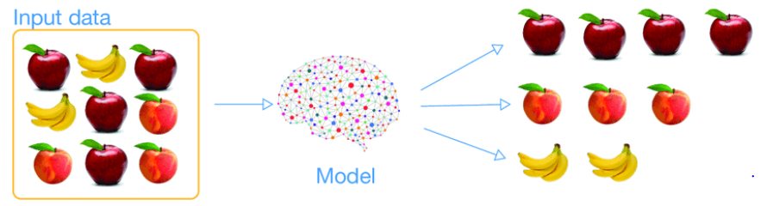
UNSUPERVISED LEARNING – CLUSTERING

Slide 45
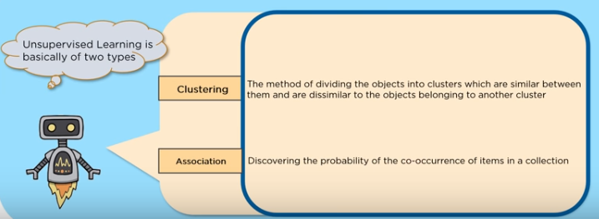
TYPES OF UNSUPERVISED LEARNING

Slide 46
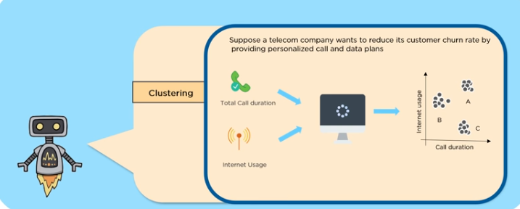
CLUSTERING EXAMPLE

Slide 47
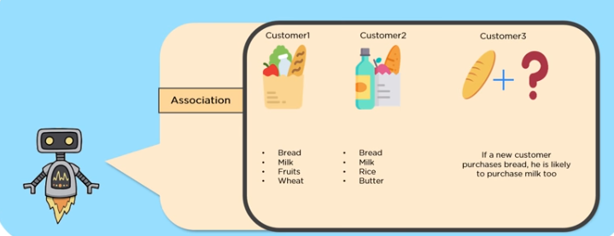
ASSOCIATION EXAMPLE

Slide 48
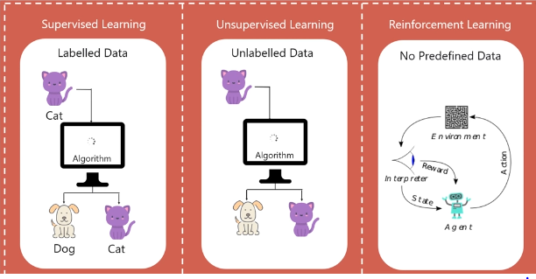
TYPES OF DATA

Slide 49
UNSUPERVISED LEARNING – CLUSTERING

Slide 50
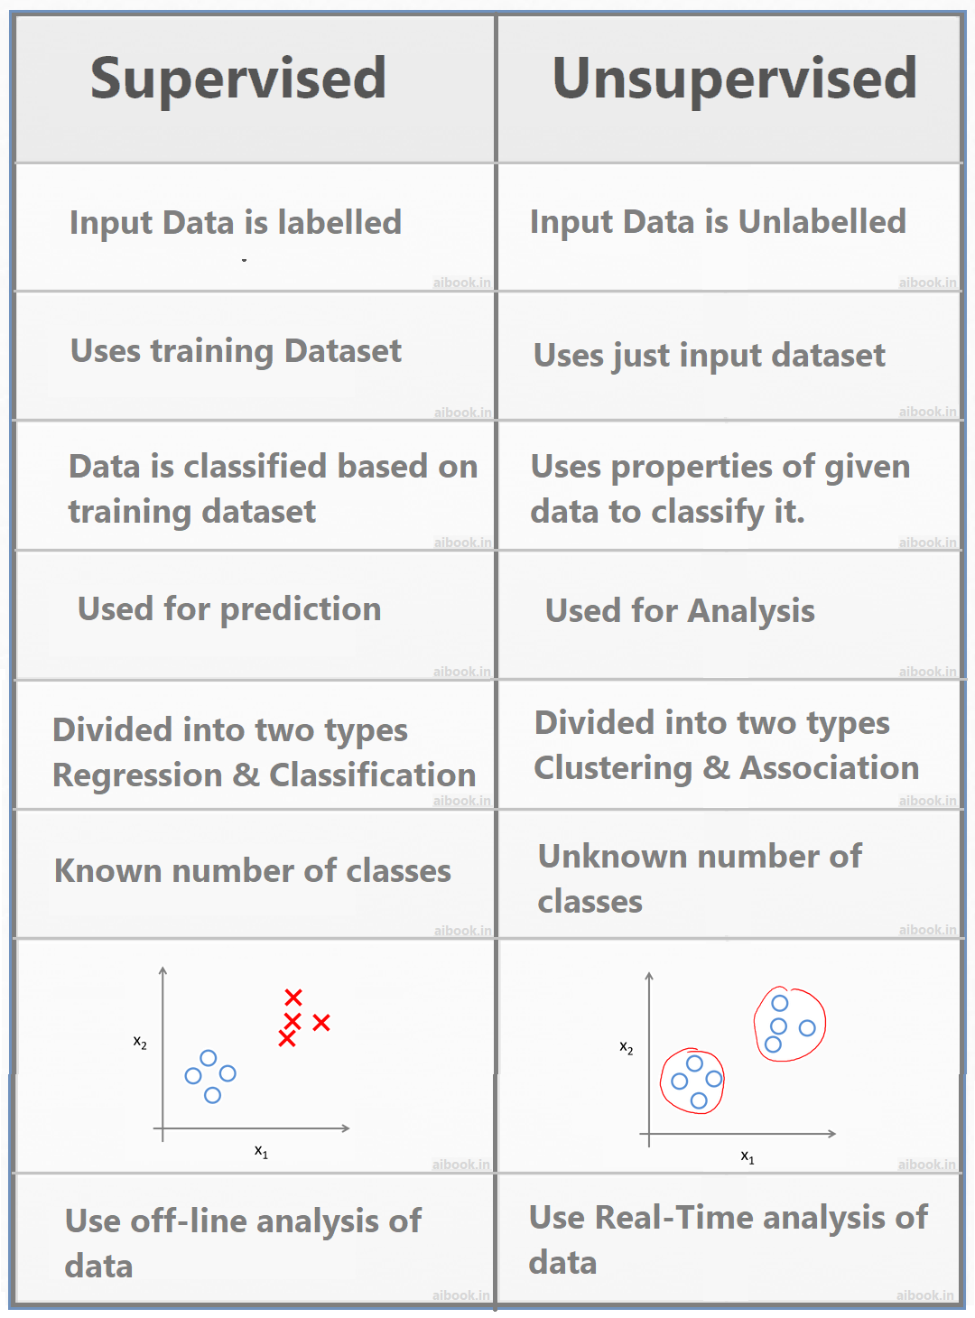

Slide 51
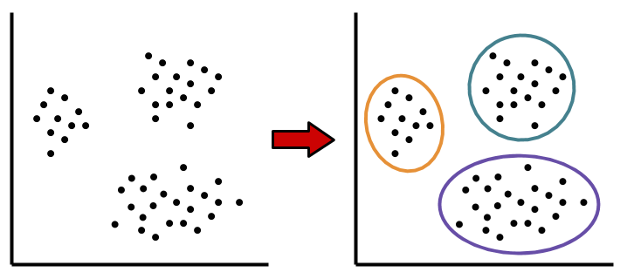
Clustering

Slide 52
K-Means Clustering
To begin, we first select a number of classes/groups to use and randomly initialize their respective center points. To figure out the number of classes to use, it’s good to take a quick look at the data and try to identify any distinct groupings.
Each data point is classified by computing the distance between that point and each group center, and then classifying the point to be in the group whose center is closest to it.
Based on these classified points, we recompute the group center by taking the mean of all the vectors in the group.
Repeat these steps for a set number of iterations or until the group centers don’t change much between iterations.

Slide 53
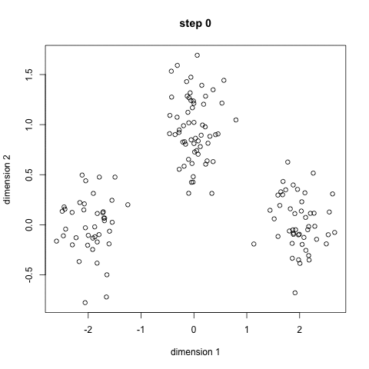

Slide 54
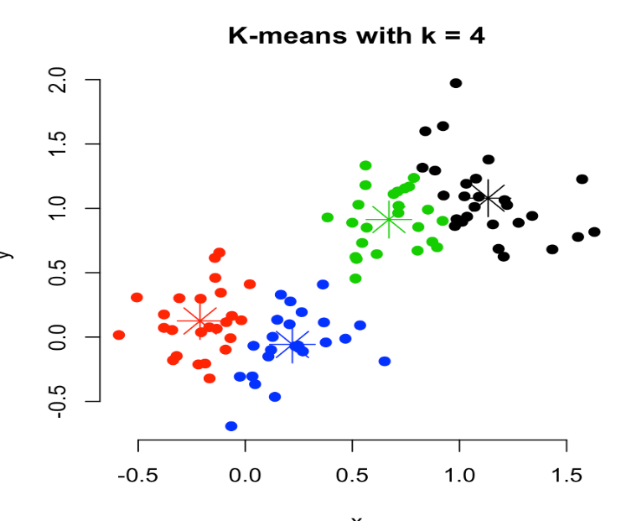
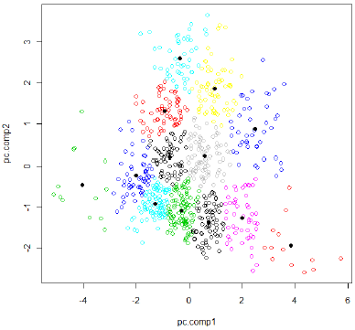
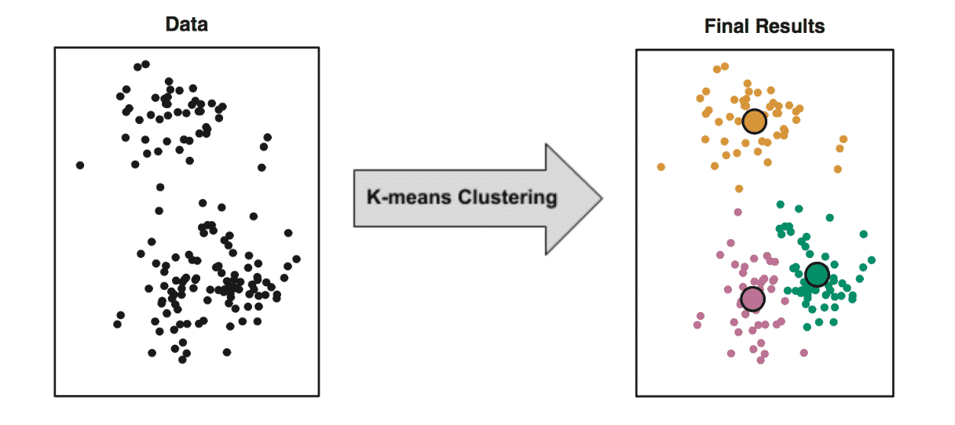
K-Means Clustering

Slide 55
Dimension Reduction Techniques
As data generation and collection keeps increasing, visualizing it and drawing inferences becomes more and more challenging.
The process of reducing the number of random variables under consideration by obtaining a set of principal variables.
Approaches can be divided into feature selection and feature extraction.

Slide 56
Why Dimension Reduction is Required
Space required to store the data is reduced as the number of dimensions comes down
Less dimensions lead to less computation/training time
Some algorithms do not perform well when we have a large dimensions. So reducing these dimensions needs to happen for the algorithm to be useful
It takes care of multicollinearity by removing redundant features. For example, you have two variables – ‘time spent on treadmill in minutes’ and ‘calories burnt’. These variables are highly correlated as the more time you spend running on a treadmill, the more calories you will burn. Hence, there is no point in storing both as just one of them does what you require
It helps in visualizing data.
It is very difficult to visualize data in higher dimensions so reducing our space to 2D or 3D may allow us to plot and observe patterns more clearly

Slide 57
Few Dimension Reduction Techniques
Missing Value Ratio
Low Variance Filter
High Correlation Filter
Random Forest
Backward Feature Elimination
Forward Feature Selection
Factor Analysis
Principal Component Analysis

Slide 58
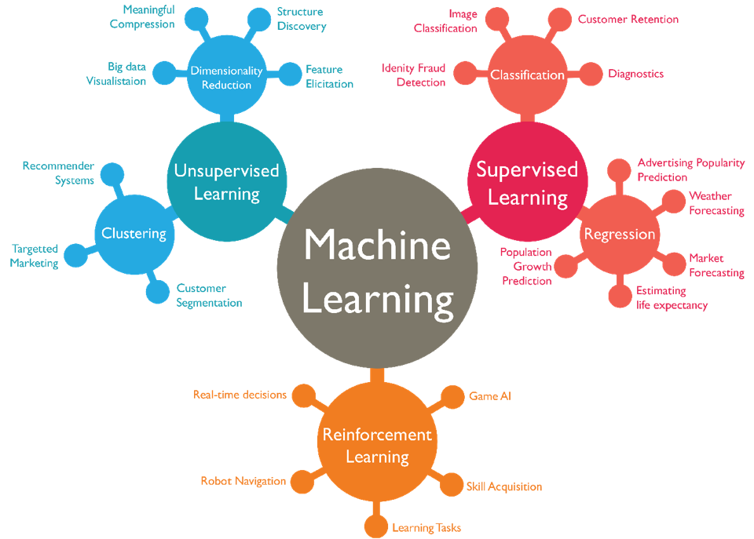

Slide 59
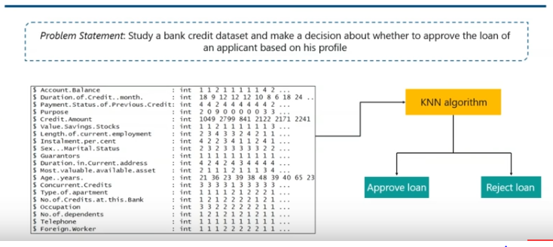
USE CASE 1

Slide 60
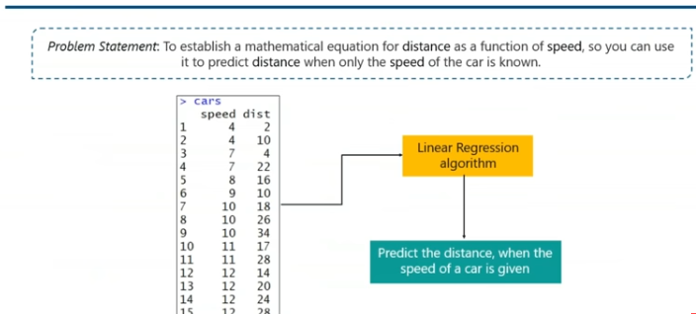
USE CASE 2

Slide 61
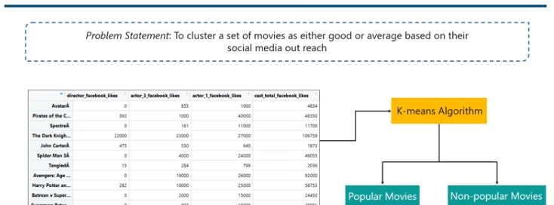
USE CASE 3

Slide 62
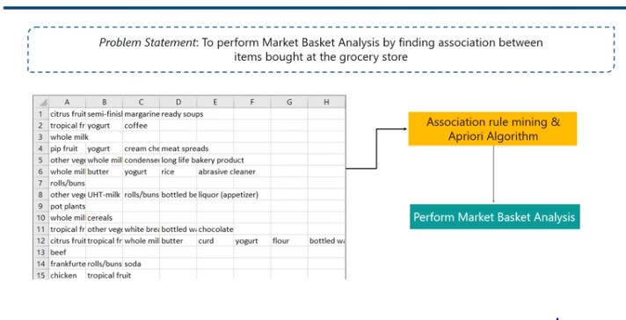
USE CASE 4

Slide 63
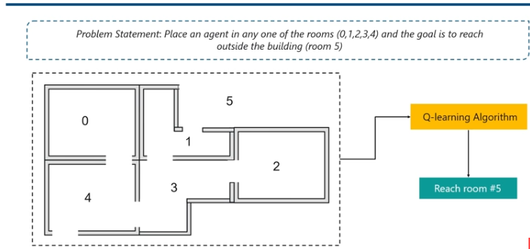
USE CASE 5

Slide 64
Supervised / Unsupervised/Reinforcement LEARNING
Predict the class of a new data by training the machine with a labeled dataset
Predicting the price of a house given a labeled dataset
Product recommendation
Predict a patient is diabetic or not given labeled dataset
Predict the arrival delay time of flights given labeled dataset
Market basket analysis
Self driving Car

Slide 65
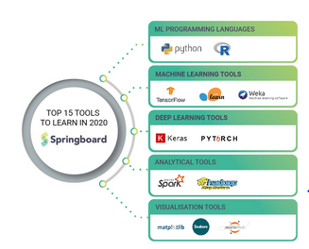

Slide 66

Contents
Uncertainty
What is Uncertainty
Causes of Uncertainty
Probabilistic Reasoning in AI
Bayes Theorem in AI
Bayesian Network in AI
Markov Model
Hidden Markov Model

Slide 67


What is Uncertainty ?

Slide 68
With this knowledge representation, we might write A→B, which means if A is true then B is true, but consider a situation where we are not sure about whether A is true or not then we cannot express this statement, this situation is called uncertainty.

Slide 69
Causes of uncertainty:
Information occurred from unreliable sources.
Experimental Errors
Equipment fault
Temperature variation
Climate change.

Slide 70

Probabilistic reasoning

Slide 71
Need of probabilistic reasoning in AI
When there are unpredictable outcomes.
When specifications or possibilities of predicates becomes too large to handle.
When an unknown error occurs during an experiment.

Slide 72
In probabilistic reasoning, there are two ways to solve problems with uncertain knowledge:
Bayes' rule
Bayesian Statistics

Slide 73
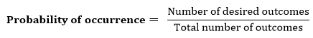
Probability:
0 ≤ P(A) ≤ 1, where P(A) is the probability of an event A.
P(A) = 0, indicates total uncertainty in an event A.
P(A) =1, indicates total certainty in an event A.

Slide 74
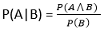
Conditional probability:
Let's suppose, we want to calculate the event A when event B has already occurred, "the probability of A under the conditions of B", it can be written as:

Slide 75
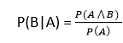
Where P(A⋀B) = Joint probability of A and B. P(B) = Marginal probability of B. If the probability of A is given and we need to find the probability of B, then it will be given as:

Slide 76
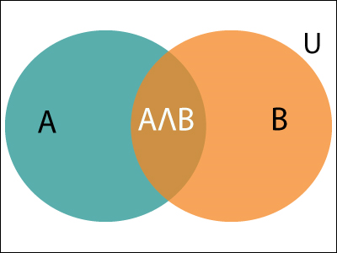

Slide 77
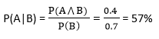
Example: In a class, there are 70% of the students who like English and 40% of the students who likes English and mathematics, and then what is the percent of students those who like English also like mathematics? Solution: Let, A is an event that a student likes Mathematics B is an event that a student likes English.

Slide 78
Bayes' theorem:
Bayes' theorem is also known as Bayes' rule, Bayes' law, or Bayesian reasoning, which determines the probability of an event with uncertain knowledge.
In probability theory, it relates the conditional probability and marginal probabilities of two random events.
It is a way to calculate the value of P(B|A) with the knowledge of P(A|B).
Bayes' theorem allows updating the probability prediction of an event by observing new information of the real world.

Slide 79
Bayes' theorem can be derived using product rule and conditional probability of event A with known event B: As from product rule we can write: P(A ⋀ B)= P(A|B) P(B) Similarly, the probability of event B with known event A: P(A ⋀ B)= P(B|A) P(A)

Slide 80

P(A|B) is known as posterior, which we need to calculate, and it will be read as Probability of hypothesis A when we have occurred an evidence B. P(B|A) is called the likelihood, in which we consider that hypothesis is true, then we calculate the probability of evidence. P(A) is called the prior probability, probability of hypothesis before considering the evidence. P(B) is called marginal probability, pure probability of an evidence.

Slide 81
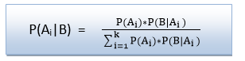
In the equation (a), in general, we can write P (B) = P(A)*P(B|Ai), hence the Bayes' rule can be written as:
Where A₁, A₂, A₃,........, A_{n} is a set of mutually exclusive and exhaustive events.

Slide 82
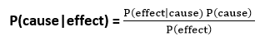
Applying Bayes' rule:
Example:
Question: From a standard deck of playing cards, a single card is drawn. The probability that the card is king is 4/52, then calculate posterior probability P(King|Face), which means the drawn face card is a king card.

Slide 83
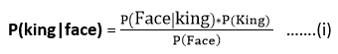
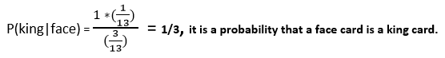
Solution:
P(king): probability that the card is King= 4/52= 1/13.
P(face): probability that a card is a face card= 3/13.
P(Face|King): probability of face card when we assume it is a king = 1
Putting all values in equation (i) we will get:

Slide 84
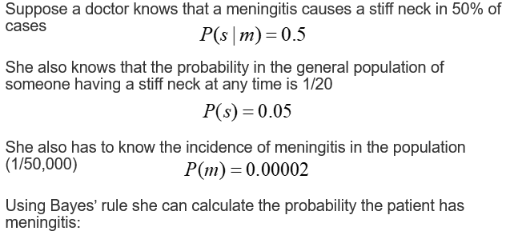


Slide 85
Application of Bayes' theorem in Artificial intelligence:
It is used to calculate the next step of the robot when the already executed step is given.
Baye’s theorem is helpful in weather forecasting.
It can solve the Monty Hall problem.

Slide 86
Bayesian Belief Network in artificial intelligence:
Bayesian Network can be used for building models from data and experts opinions, and it consists of two parts:
Directed Acyclic Graph.
Table of conditional probabilities.

Slide 87


Slide 88
Each node in the Bayesian network has condition probability distribution P(X_{i} |Parent(X_{i}) ), which determines the effect of the parent on that node. Bayesian network is based on Joint probability distribution and conditional probability. So let's first understand the joint probability distribution:

Slide 89


Slide 90


Slide 91


Slide 92

Bayes’ nets
Can be captured in a picture, where the arcs capture conditional independence relationships

Slide 93

Bayesian Network

Slide 94

Define : Bayesian Network

Slide 95

Contd..

Slide 96


DAG

Slide 97

Cont’d..

Slide 98

Example

Slide 99

Cont’d..

Slide 100

Inference

Slide 101

Cont’d..

Slide 102

Bayesian Networks : Properties

Slide 103

Why BN?

Slide 104

Conclusion

Slide 105












Bayesian Network constitutes of..
Directed Acyclic Graph (DAG)
Set of conditional probability tables for each node in the graph
A
B
C
D

Slide 106


Where do all these numbers come from?
A
B
C
D

Slide 107
Cont..calculations on the belief network
Using the network in the example, suppose you want to calculate:
P(A = true, B = true, C = true, D = true)
This is from the
graph structure
= P(A = true) * P(B = true | A = true) *
P(C = true | B = true) P( D = true | B = true)
= (0.4)*(0.3)*(0.1)*(0.95)
These numbers are from the
conditional probability tables

Slide 108













The infamous Burglary-Alarm Example
P(B) 0.001
P(E) 0.002
Burglary
Earthquake
B E P(A)
T T 0.95
T F 0.94
F T 0.29
F F 0.001
Alarm
A P(J)
John Calls
T 0.90
F 0.05
Mary Calls
A P(M)
T 0.70
F 0.01

Slide 109
So let’s see how you can calculate P(John called) if there was a burglary?
Inference from effect to cause; Given a burglary, what is P(J|B)?
P(J | B) = ?
P( A | B) = P(B)P(¬E)(0.94) + P(B)P(E)(0.95)
P( A | B) = 1(0.998)(0.94) + 1(0.002)(0.95)
P( A | B) = 0.94
P(J | B) = P( A)(0.9) + P(¬A)(0.05)
P(J | B) = (0.94)(0.9) + (0.06)(0.05)
= 0.85

Slide 110
So let’s see how you can calculate P(John called) if there was a burglary?
Can also calculate P (M|B) = 0.67

Slide 111


Slide 112


Slide 113


Slide 114


Slide 115


Slide 116


Slide 117


Slide 118


Slide 119
Three Basic Types Of Probabilities
Joint probability: Likelihood of a completely specified state of events, e.g. P(ABCDE)
Marginal probability: Likelihood of an incompletely specified state of events, e.g. P(ACD) or P(E)
Conditional probability: Likelihood of an event given some known information, e.g. P(A|C) or P(DE|AB)

Slide 120
Joint probability distribution:
If we have variables x1, x2, x3,....., xn, then the probabilities of a different combination of x1, x2, x3.. xn, are known as Joint probability distribution.
P[x₁, x₂, x₃,....., x_{n}], it can be written as the following way in terms of the joint probability distribution.
= P[x₁| x₂, x₃,....., x_{n}]P[x₂, x₃,....., x_{n}]
= P[x₁| x₂, x₃,....., x_{n}]P[x₂|x₃,....., x_{n}]....P[x_{n-1}|x_{n}]P[x_{n}].

Slide 121


Slide 122
Markov Models
Set of states:
Process moves from one state to another generating a sequence of states :
Markov chain property: probability of each subsequent state depends only on what was the previous state:
To define Markov model, the following probabilities have to be specified:
Transition probabilities
Initial probabilities

Slide 123
Example of Markov Model
0.3
0.7
Rain
Dry
0.2
0.8
Two states : ‘Rain’ and ‘Dry’.
Transition probabilities:
P(‘Rain’|‘Rain’)=0.3 ,
P(‘Dry’|‘Rain’)=0.7 ,
P(‘Rain’|‘Dry’)=0.2,
P(‘Dry’|‘Dry’)=0.8
Initial probabilities: say P(‘Rain’)=0.4 , P(‘Dry’)=0.6 .

Slide 124


Slide 125


Slide 126


Slide 127


Slide 128
Hidden Markov Model
Hidden Markov Model (HMM) is a statistical Markov model in which the system being modeled is assumed to be a Markov process with unobserved (i.e. hidden) states.
Hidden Markov models are especially known for their application in reinforcement learning and temporal pattern recognition such as speech, handwriting, gesture recognition, part-of-speech tagging, musical score following, partial discharges and bioinformatics.

Slide 129
Terminology in HMM
The term hidden refers to the first order Markov process behind the observation. Observation refers to the data we know and can observe. Markov process is shown by the interaction between “Rainy” and “Sunny” in the below diagram and each of these are HIDDEN STATES.
Refer the figure in next slide:

Slide 130


Slide 131


Slide 132


Slide 133


Slide 134
OBSERVATIONS are known data and refers to “Walk”, “Shop”, and “Clean” in the above diagram. In machine learning sense, observation is our training data, and the number of hidden states is our hyper parameter for our model. Evaluation of the model will be discussed later.

Slide 135


Slide 136
T = don’t have any observation yet, N = 2, M = 3, Q = {“Rainy”, “Sunny”}, V = {“Walk”, “Shop”, “Clean”} State transition probabilities are the arrows pointing to each hidden state. Observation probability matrix are the blue and red arrows pointing to each observations from each hidden state. The matrix are row stochastic meaning the rows add up to 1.

Slide 137


Slide 138


Slide 139

HMM : Assumptions

Slide 140

HMM : Definition

Slide 141

HMM : Dependency Structure

Slide 142
HMM
Your friends activities:
Basketball (B)
Football (F)
Video games (G)
Observable symbols:
Sunny (S)
Cloudy (C)
Rainy (R)

Slide 143

Contd..

Slide 144

Cont’d..

Slide 145

Contd..

Slide 146

Cont’d..

Slide 147

Contd..

Slide 148

Example

Slide 149
Start
Rainy
Sunny
Walk
Clean
Shop

Slide 150


Slide 151


Example – Face Recognition

Slide 152


Slide 153


Slide 154


Slide 155


Slide 156


Slide 157


Slide 158


Slide 159


Slide 160

Problems in HMM

Slide 161


Slide 162


Slide 163


Slide 164


Slide 173


